Slide 1
WINE QUALITY PREDICTION
Creating a way to predict the quality of wine using Machine Learning methods
We will explore different methods and discover if the same method is applicable for both red and white wines

Slide 2

The global wine industry is huge
No producer wants to get a bad reputation and risk sales
The global wine industry is worth around US$350billion annually
Globally 232 million hectolitres of wine is consumed per year
That is over 30,933,333,333 bottles
There are over 90,000 wine producers in the world
Nearly 1 million people work in the wine industry worldwide
No one likes bad wine!

Slide 3
Data Source:
Kaggle
Data Format:
Red: csv, 1599 lines, 12 columns with headers, size on disc 98.6kb
White: csv, 4898 lines, 12 columns with headers, size on disc 262kb
Data Explained:
Fixed Acidity = Any non-volatile acids (do not evaporate easily)
Volatile Acidity = Acetic acid. Too higher levels result in vinegar taste
Citric Acid = Usually found in smaller quantities. Can add ‘freshness’
Residual Sugar = Amount of sugar remaining after fermentation. Affects sweetness
Chlorides = Salt
Free Sulfur Dioxide = Unbound with other elements. Helps preserve
Total Sulfur Dioxide = Free and bound
Density = Expressed as a percentage of water (being 1)
pH = Measure of acidity or base on a scale of 1 to 14
Sulphates = An antimicrobial. Another method of preserving
Alcohol = The fun bit
Quality = Rated on a scale of 0 to 10
Citations: P. Cortez, A.Cerdeira, F.Almeida and J.Reis Modeling wine preferences by data mining from physicochemical properties. In Decision Support Systems, Elsevier, 47(4):547-533, 2009.

Slide 4

Five different colab notebooks were employed for each wine type. One for data insights and four more each to try different ML approaches.
The exact same approaches were tried on each data set.
These can be found on my GitHub repository HERE.

Slide 5
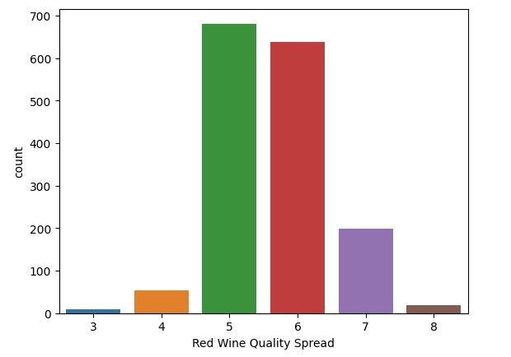
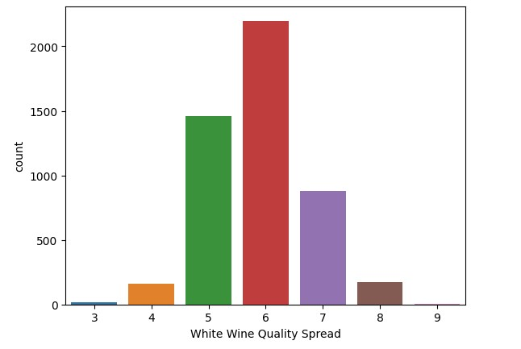
Data Insights: Visualising our Quality (target) spread
RED
WHITE

Slide 6
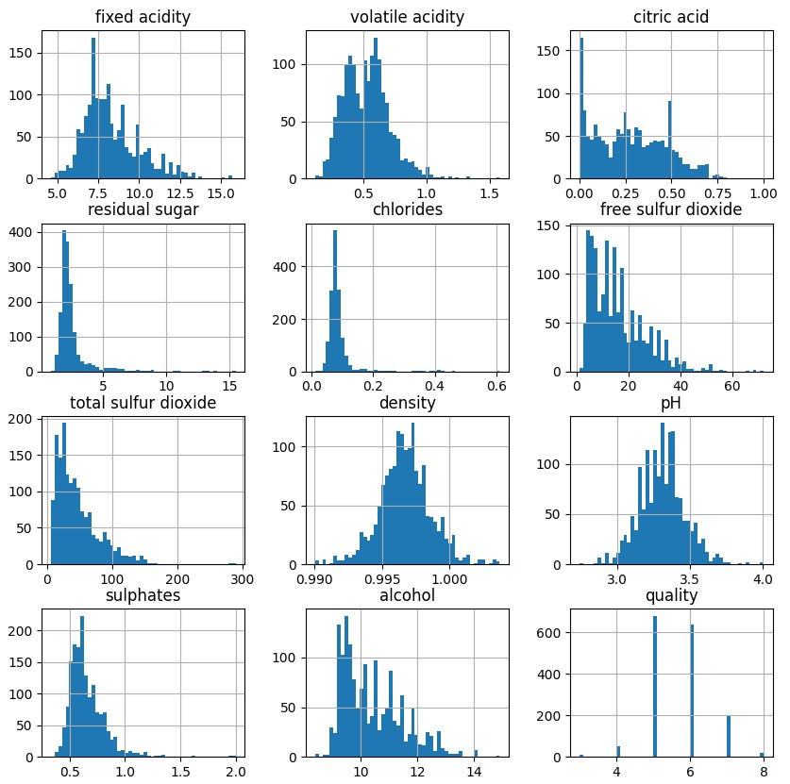
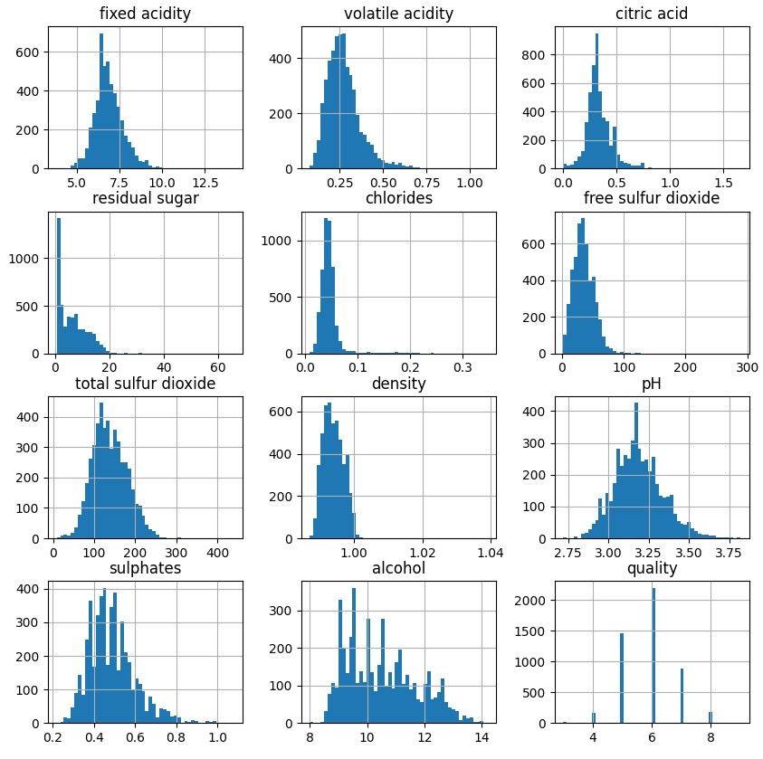
Data Insights: Visualising our constituent spread (histogram)
RED
WHITE

Slide 7
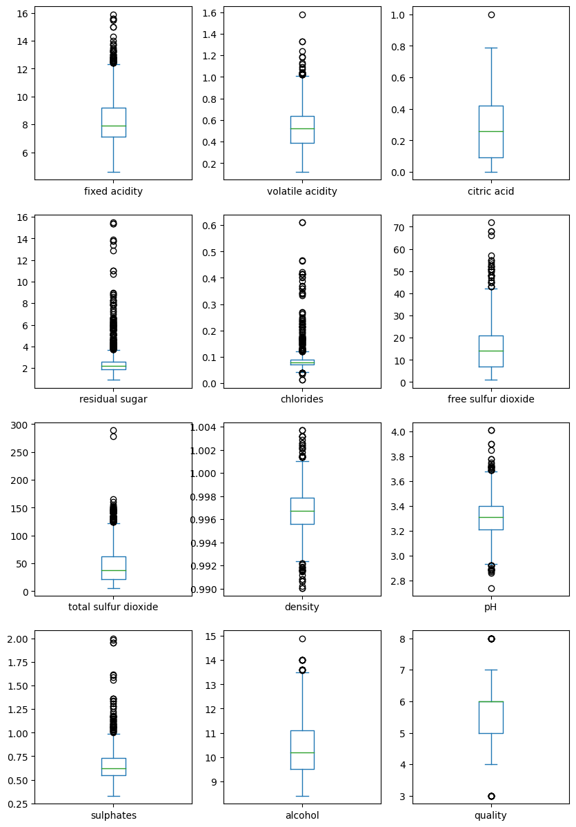
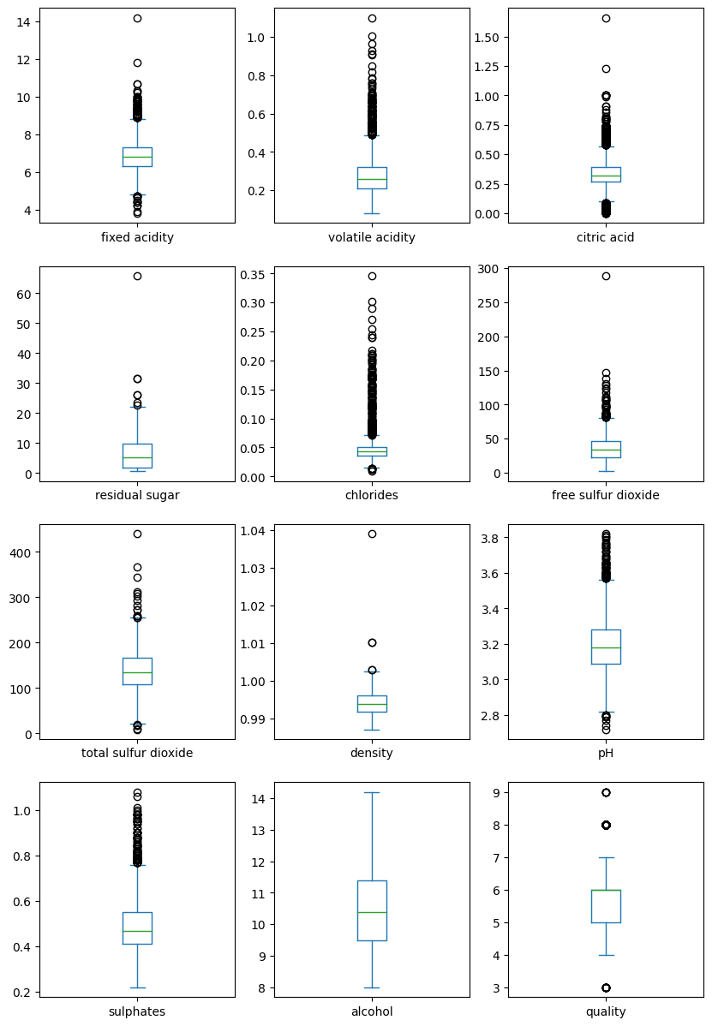
Data Insights: Visualising our Outliers (box plots)
RED
WHITE

Slide 8
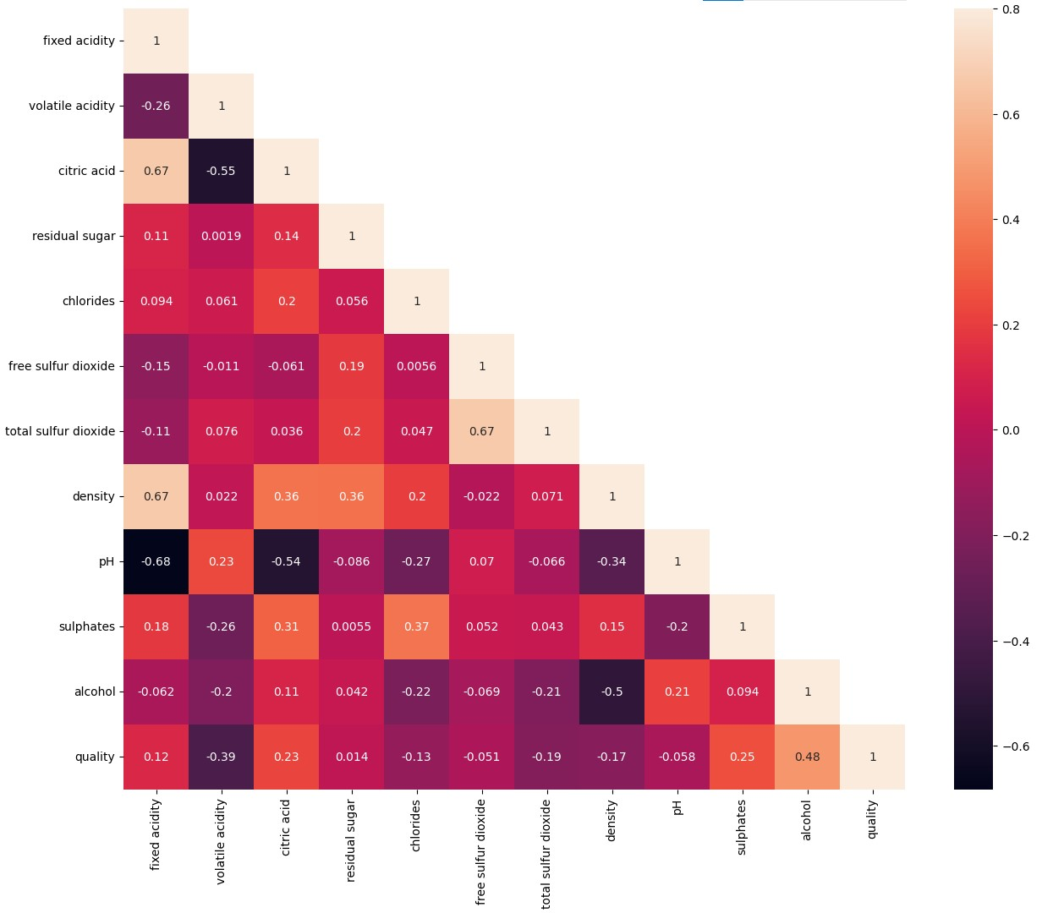
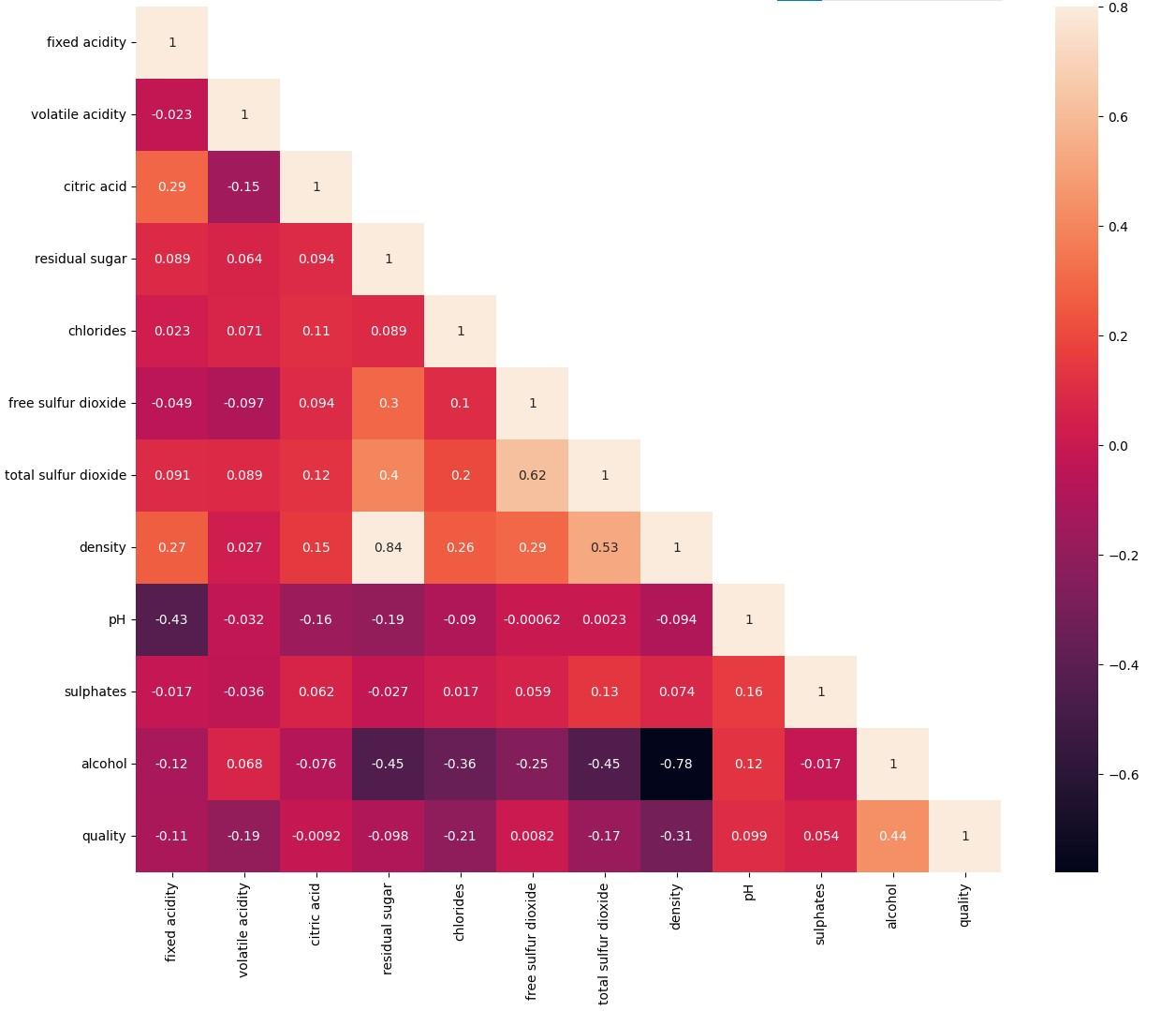
Data Insights: Visualising Correlation of all constituents (heat maps)
RED
WHITE

Slide 9
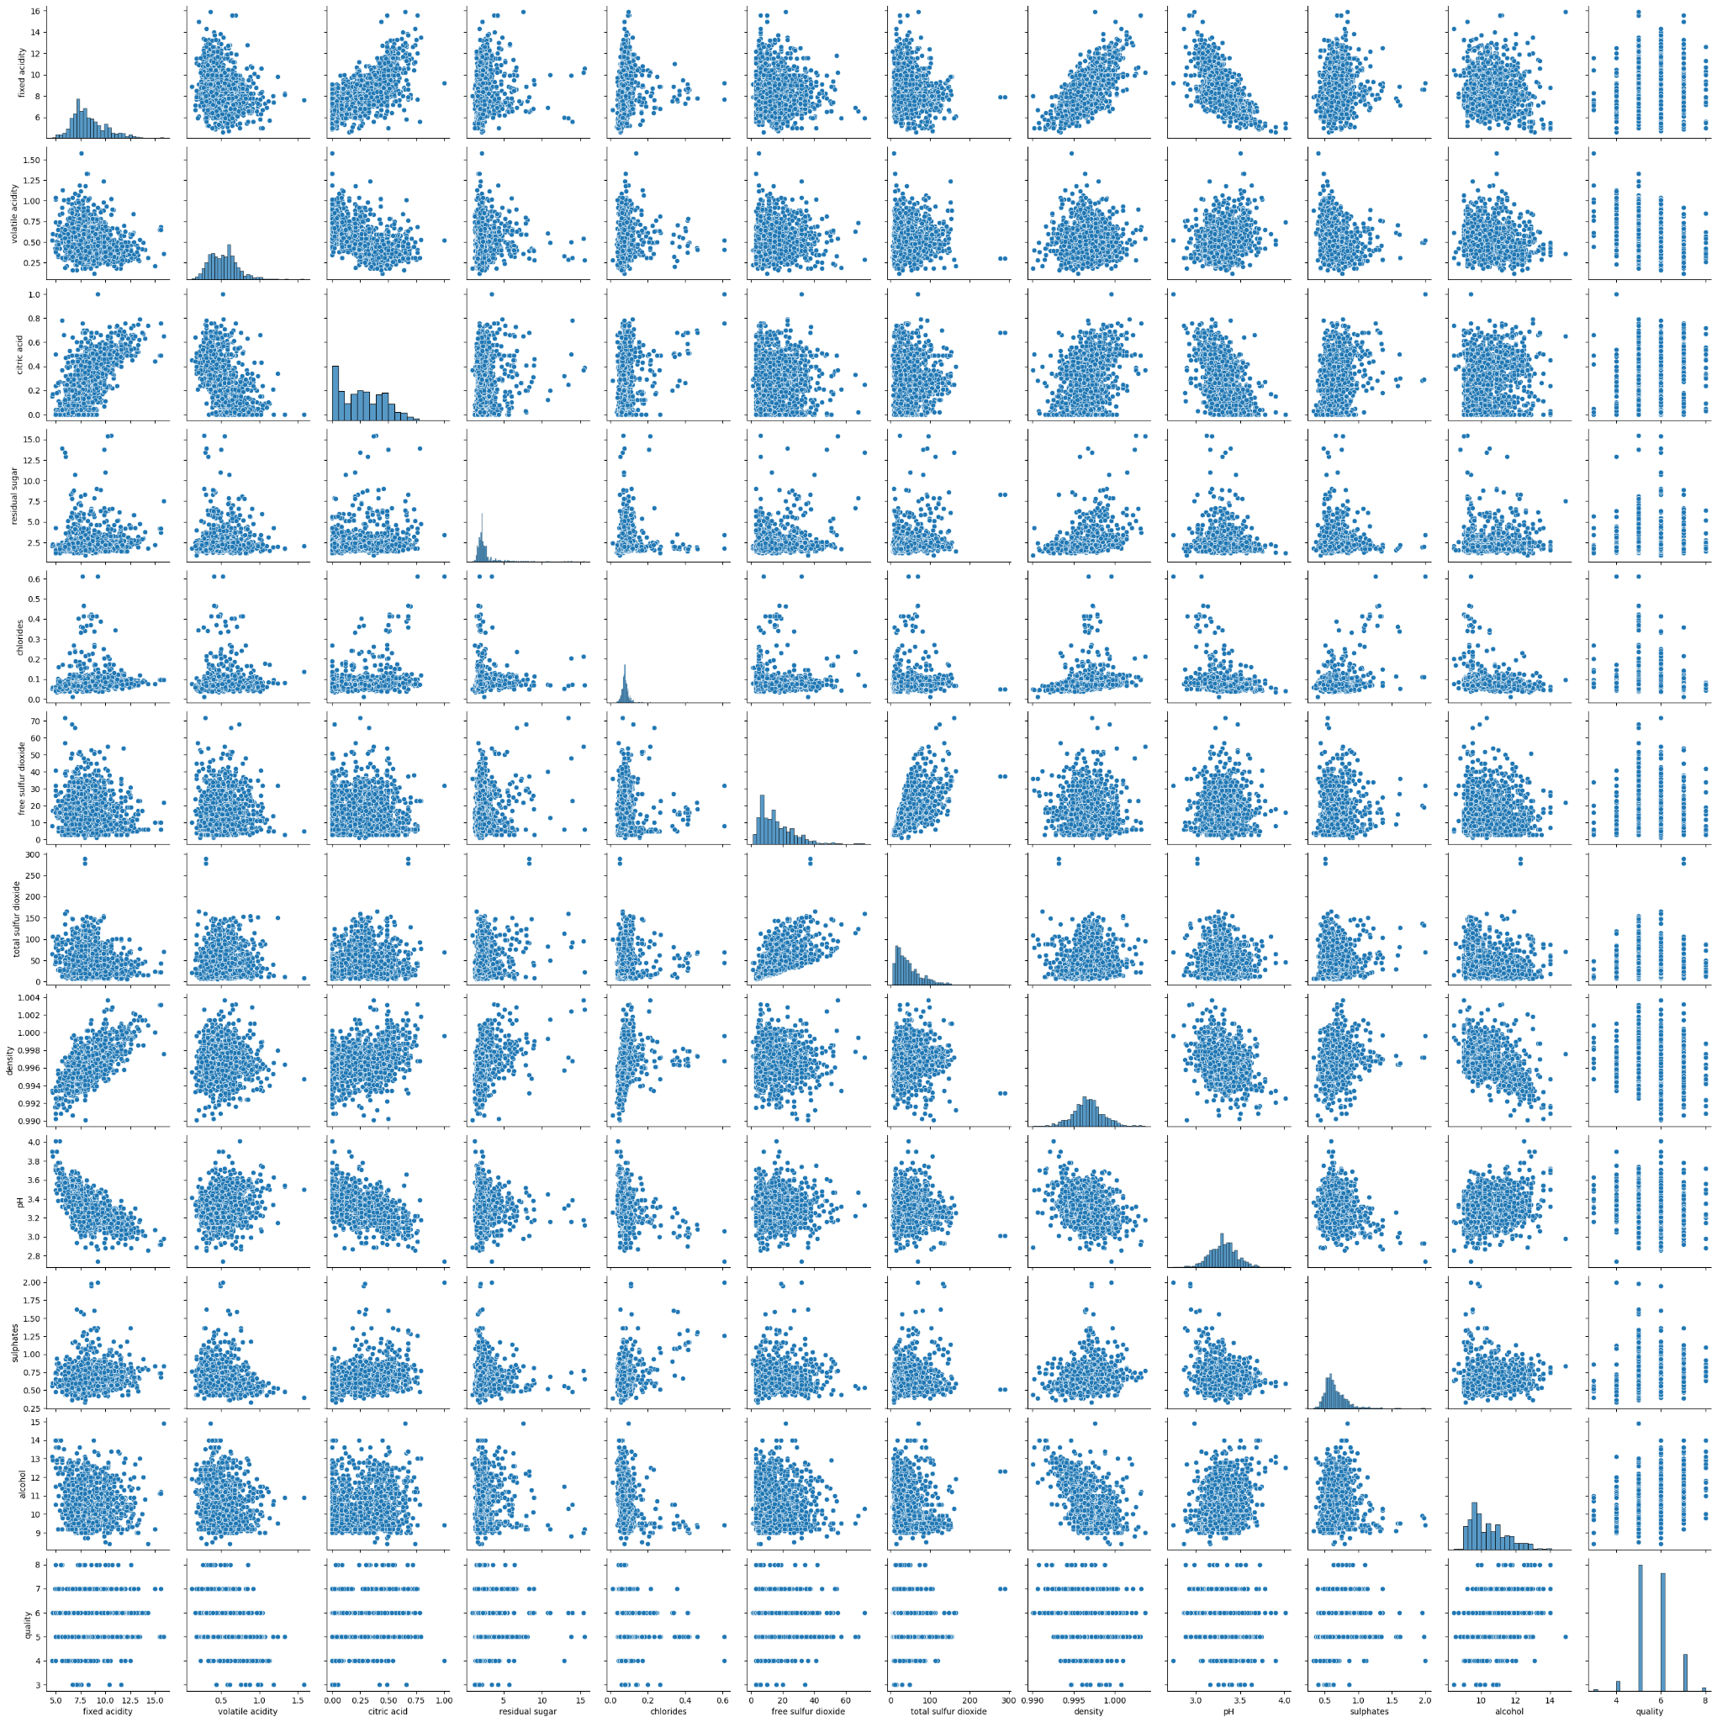
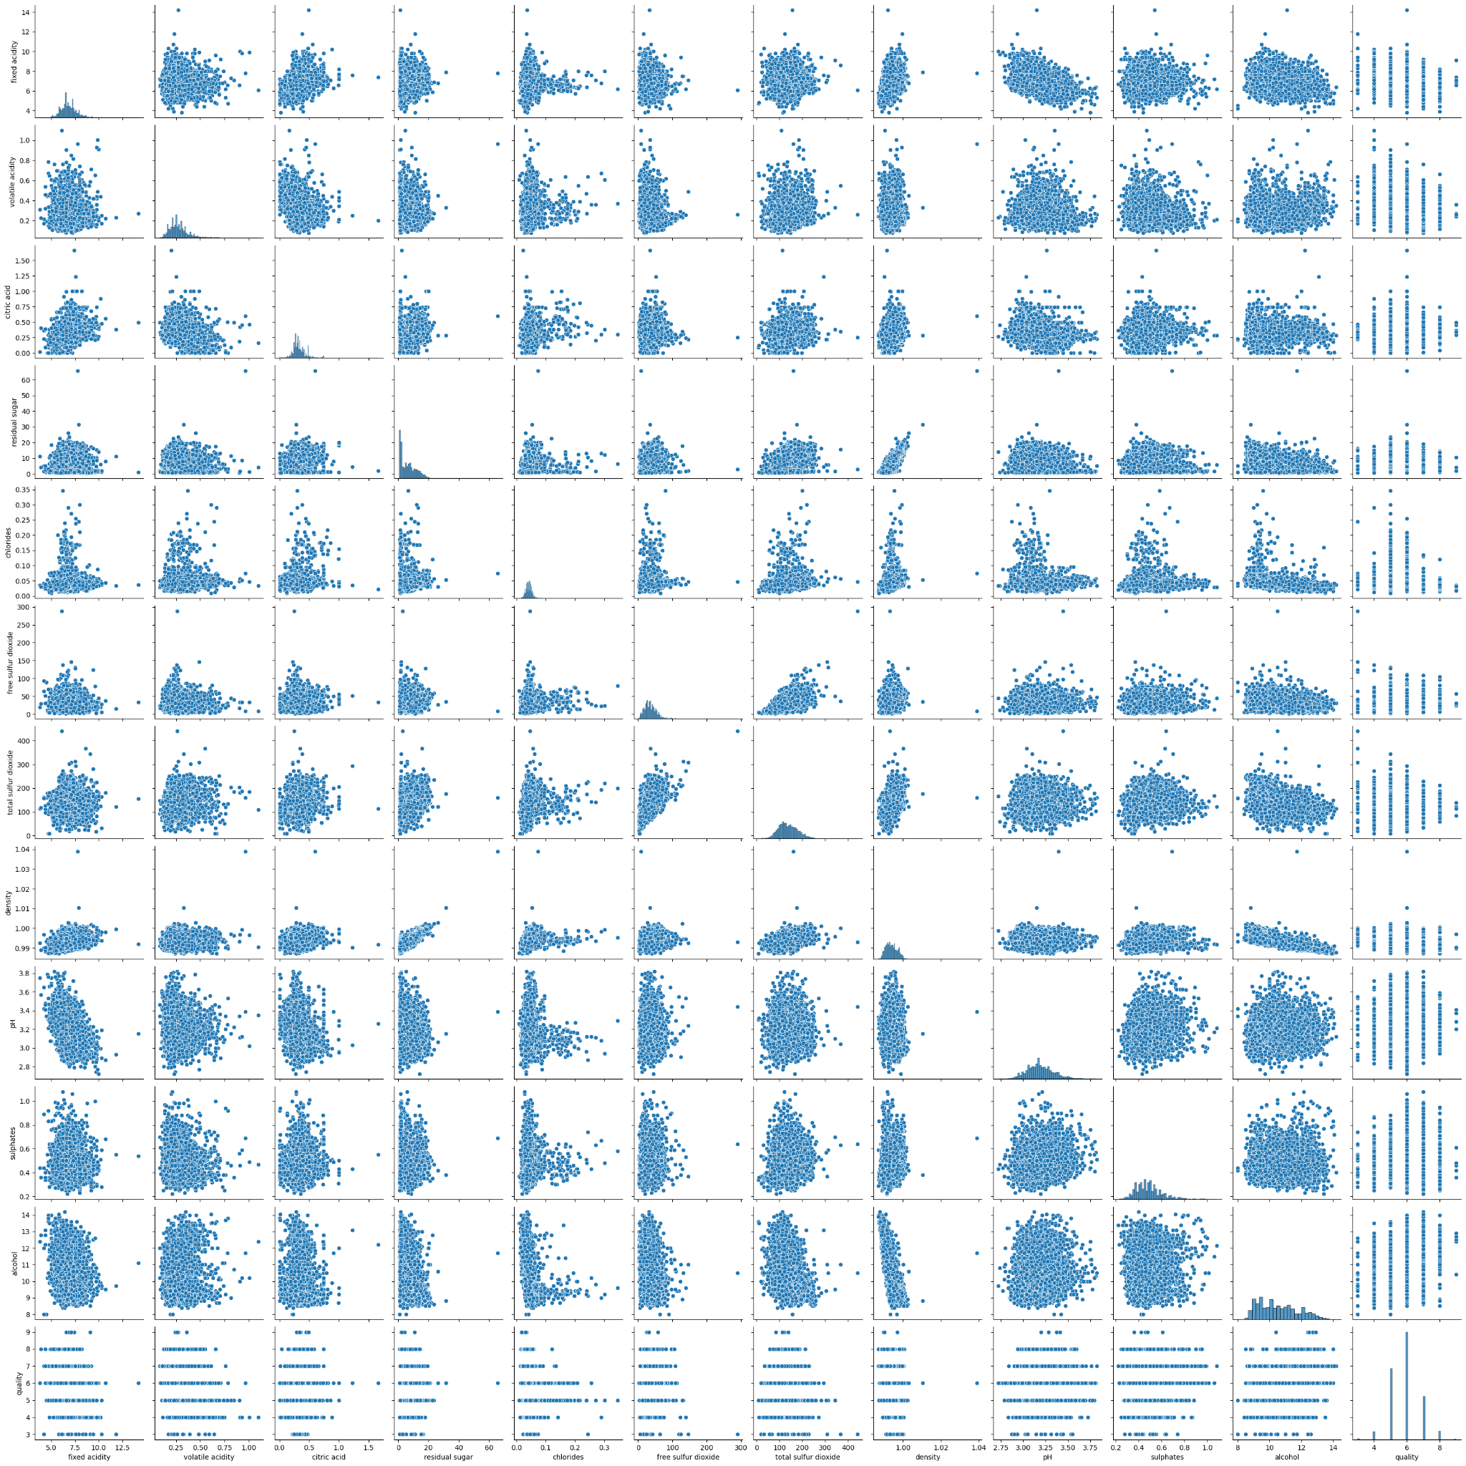
Data Insights: Visualising Correlation of all constituents (pair plots)
RED
WHITE

Slide 10
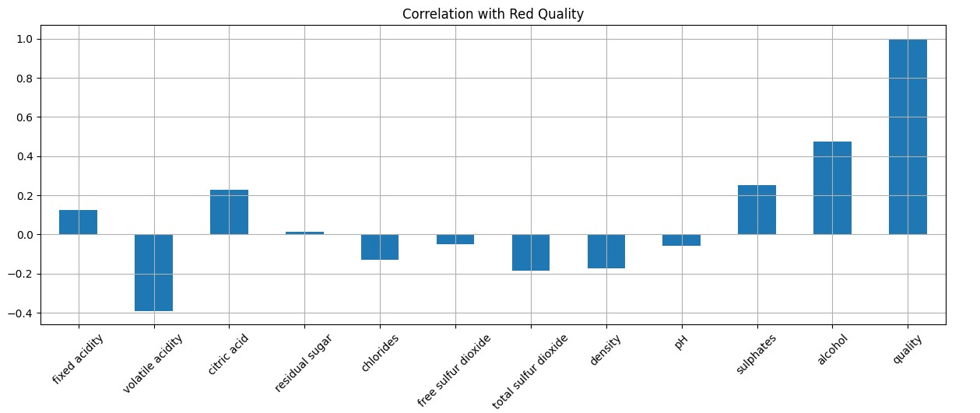
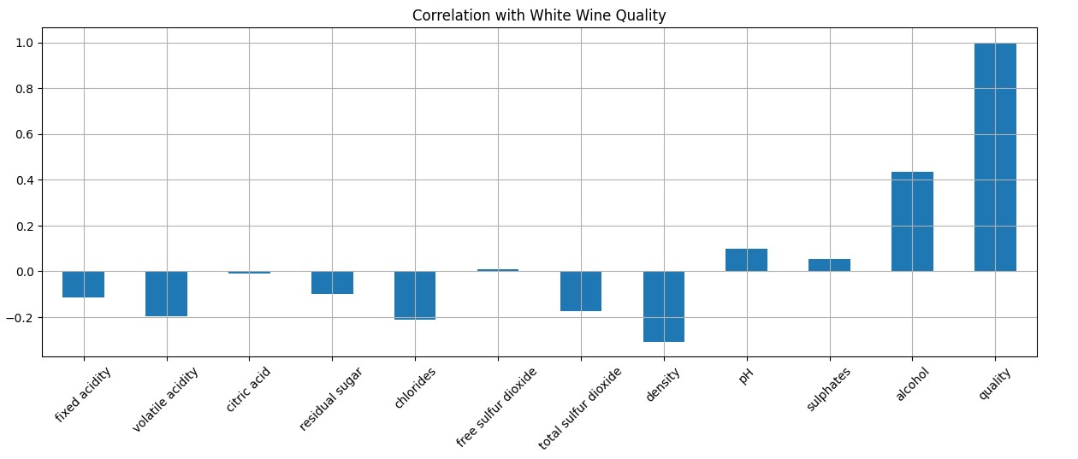
Data Insights: Visualising Correlation to Quality (bar)
RED
WHITE

Slide 11
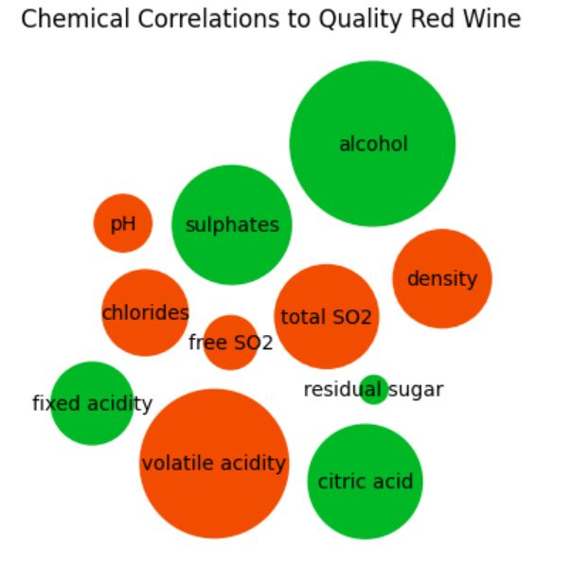
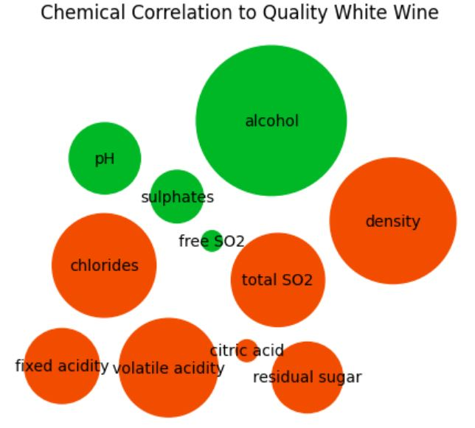
Data Insights: Visualising Correlation to Quality (bubble plots)
Green = Positive Correlation, Orange = Negative Correlation
RED
WHITE

Slide 12
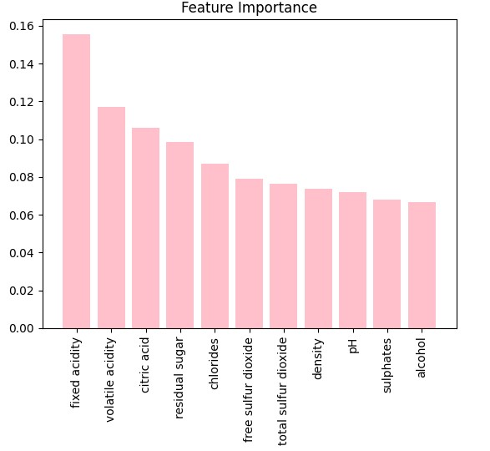
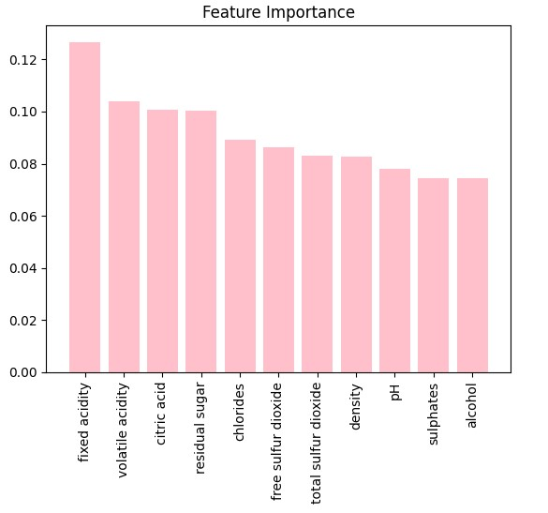
Data Insights: Visualising feature importance (bar chart)
RED
WHITE

Slide 13
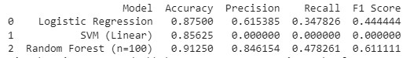
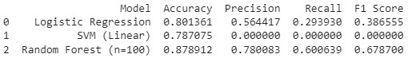
ML Approaches: Supervised x 3
The data was binned so that wine with a quality rating of 7 or above was considered good.
The data was scaled using standard scaler
Methods used were
Logistic Regression
Support Vector Machine
Random Forest
RED
WHITE
Results:
Random Forest performed the best on both data sets.
All methods performed better on the red wine data.
Random Forest ‘fell away,’ the least on the white wine set, approx. 3% compared to the other 2 models approx. 7%

Slide 14
ML Approaches: Basic neural network (manual parameters)
The data was binned so that wine with a quality rating of 7 or above was considered good.
The data was scaled using standard scaler
Parameters used were
Input layer = 16 (relu)
1st hidden layer = 16 (relu)
Output layer = (sigmoid)
Epochs = 50
RED
WHITE
Results:
A basic neural network approach with only one hidden layer and 50 epochs yielded better results than simple Logistic Regression or SVM but not as good as Random Forest on both data sets. Again the model ‘fell away’ by approx. 7% on the white wine data.

Slide 15
ML Approaches: Deep Learning neural network (manual parameters)
The data was binned so that wine with a quality rating of 7 or above was considered good.
The data was scaled using standard scaler
Parameters used were
Input layer = 16 (relu)
3 hidden layers = 16 (relu)
Output layer = (sigmoid)
Epochs = 100
RED
WHITE
Results:
Improved accuracy on both data sets over the basic, one hidden layer approach. But still not as good as Random Forest. Although close on the red set it was a considerably worse on the white set. Although not recorded the 100 epochs used marginally improved the result over 50.

Slide 16
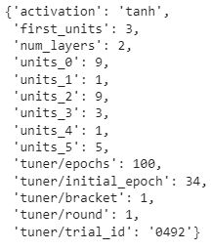

ML Approaches: Deep Learning neural network (hyperband tuning)
The data was binned so that wine with a quality rating of 7 or above was considered good.
The data was scaled using standard scaler
Parameters used were
Max neurons = 10
Activation choices = relu, tanh & sigmoid
Hidden layers = up to 6
Epochs = 100
RED
WHITE

Slide 17
ML Approaches: Deep Learning neural network (hyperband tuning)
The data was binned so that wine with a quality rating of 7 or above was considered good.
The data was scaled using standard scaler
Parameters used were
Max neurons = 10
Activation choices = relu, tanh & sigmoid
Hidden layers = up to 6
Epochs = 100
RED
WHITE
Results:
This approach was the most accurate on the red wine data set, only just eclipsing Random Forest. But it took 100 Epochs and a considerably longer time to do so. It was still unable to eclipse Random Forest on the white wine set and still ‘fell away’ over 7% between sets.

Slide 18

Summary: Although a hyperband tuning derived model performed the best on the red wine set it was very close and the small improvement of 0.75% over the simple Random Forest method may not be worth the run time. Random Forest still performed the best on the white wine set, beating the next best (hyperband) by nearly 4%.
There was also a difference in accuracy between the best methods of over 4% between the datasets and every method performed worse on the white set than the red.
Why is there such a difference in accuracy between data sets?: Initial thoughts started with correlation. But review of the data (slide 11 especially) would seem to suggest that although different constituents are correlated differently both data sets contain a similar total amount, be it positive or negative, to provide a solid foundation.

Slide 19
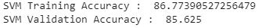
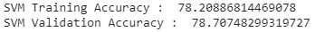
Why is there such a difference in accuracy between data sets?: I then considered that maybe it was due to under or over fitting on either data set so checked the training and validation scores on the 3 simplest methods red v white.
It is interesting that the training v validation scores for the LR & SVM models are closely matched but quite short of 100%. This may indicate underfitting of these models.
The Random Forest method netted near 100% for both data sets training accuracy and 10% to 13% less on the test data. Whilst this is a fairly good result it may indicate there is some overfitting in this case, especially on the white wine set. Other parameters were tried including varying the n_estimators, adding different max_depth, min_samples_split and max_leaf_nodes. None of these had much effect apart from max_depth. However this effect was deleterious and knocked the results down below that of the SVM method for both train and test. Although it did bring them closer together.
RED
WHITE

Slide 20
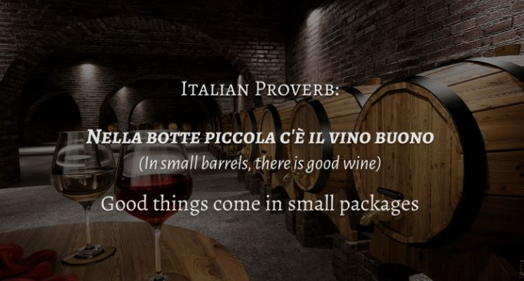
Conclusion: Given the small difference in accuracy between the model picked by the Deep Learning Hyperband Tuner and Random Forest methods on the red data set and the superior performance of the Random Forest method on the white wine set my suggestion would be to implement the Random Forest method for both wine types. I would also suggest that further fanaggling of the Random Forest method may also be able to improve its performance further.
So it would seem that despite more complex methods, Random Forest proves the below proverb!

